Slide 1



CIT 596 MODULE 12.2
Non-deterministic Polynomial Time (NP)
Sampath Kannan

Slide 2



BEYOND P
We have painted a rosy picture for algorithmic solutions, by picking problems that have polynomial time solutions and designing poly-time algorithms for them.
The problems you will encounter in the real world and in your careers will often not have such efficient solutions.
Many of these decision problems share an interesting feature: if you are given a YES instance of the problem, and a “solution” to this YES instance, then you can verify that this is a YES instance in polynomial time .
For example:
A Hamilton cycle (HC) in a graph is a simple cycle that passes through all vertices.
The HC decision problem is: given a graph $G$, does it have a Hamilton cycle?
We believe it is a hard problem, but if a certain $G$ is a YES instance, and we were also given the Hamilton cycle itself, we could efficiently verify this and confirm that it is a YES instance.

Slide 3


VERIFYING THAT $G$ HAS A HAMILTON CYCLE
The verification algorithm is given two inputs: $G$ and a proposed Hamilton cycle $v_{1},v_{2},⋯,v_{n},v_{1}$.
It first checks that the cycle is simple and passes through all vertices, by checking that every vertex occurs and that no vertex occurs twice (except the start and end vertices).
Next, it confirms that each $(v_{i},v_{i+1})$ for $i=1, 2,⋯,n−1 \text{is} \text{an} \text{edge} \text{in} G$. It also checks that $(v_{n},v_{1})$ is an edge.
Now it is convinced that $G$ is a YES instance.
NOTE that we are not saying we can efficiently find the Hamilton cycle!
We are just saying that, given the cycle, we can verify that $G$ is a YES instance.

Slide 4

“NP”
Many difficult problems you will encounter share this property: for YES instances, there is a “solution” that can be easily verified.
Such a solution is called many names: certificate, proof, or witness.
A decision problem $π \text{is} \text{in} \text{NP}$(read as “non-deterministic polynomial time”) if there is a polynomial time verification algorithm $V$such that:
If $x$ is a YES instance of $π$, there exists a certificate $y$whose length is polynomial in $\left|x\right|$such that $V\left(x,y\right)$ accepts.
If $x$ is a NO instance of $π$, then for any string $y$, $V\left(x,y\right)$ rejects.
Again, note that we are not talking about computing $y$ efficiently. In fact we believe that, for many problems in NP, there is no efficient way to compute $y$!

Slide 5

MAXIMUM CLIQUE
7
17
8
16
1
9
6
2
15
10
5
3
4
14
11
13
12
Given a graph G and a number K , are there K vertices in G that are all pairwise adjacent?
This is called a clique.
Useful for finding groups of mutual friends in social networks.
Certificate: the $K$ vertices that form the clique. Verification is straightforward.

Slide 6
3-COLORING
6
1
10
7
5
2
4
3
9
8
Given a graph G, can we assign 3 colors to its vertices so that any pair of adjacent vertices have different colors?
Useful for allocating frequencies to radio stations to avoid interference, deciding which activities to schedule in which rooms, or allocating registers to variables in a program.
Certificate: the colors of the vertices. Easy to verify coloring by examining all edges.

Slide 7
PARTITION PROBLEM
1 | 5 | 2 | 4 | 3 | 7
1 | 5 | 2 | 4 | 3 | 7
Given n numbers, can they be partitioned into 2 sets such that the sums of the numbers in the sets are equal?
Certificate: the actual partition into two sets. Easy to verify that each part adds to the same total.

Slide 8
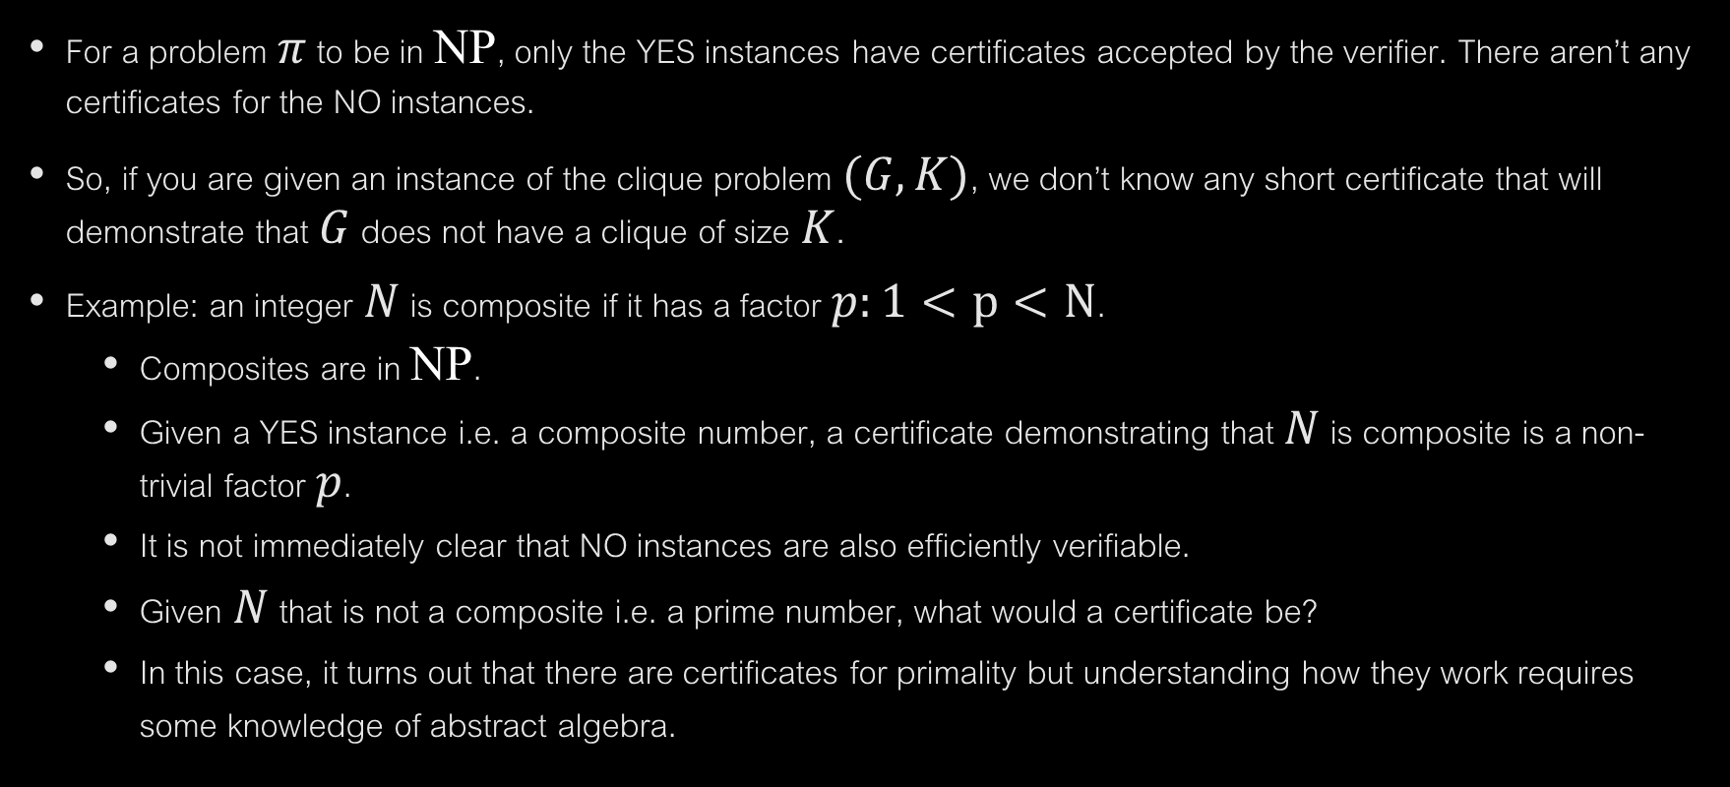
ASYMETRY IN DEFINITION
For a problem $π$ to be in NP, only the YES instances have certificates accepted by the verifier. There aren’t any certificates for the NO instances.
So, if you are given an instance of the clique problem $(G,K)$, we don’t know any short certificate that will demonstrate that $G$ does not have a clique of size $K$.
Example: an integer $N$ is composite if it has a factor $p:1<p<N$.
Composites are in NP.
Given a YES instance i.e. a composite number, a certificate demonstrating that $N$ is composite is a non-trivial factor $p$.
It is not immediately clear that NO instances are also efficiently verifiable.
Given $N$ that is not a composite i.e. a prime number, what would a certificate be?
In this case, it turns out that there are certificates for primality but understanding how they work requires some knowledge of abstract algebra.

Slide 9

“Co-NP”
Given the asymmetry we observed, we could define a complexity class of problems for which NO instances can be efficiently verified.
This is the class Co-NP.
Observe that PRIMES $∈$ Co-NP because:
A NO instance of PRIMES is a composite number.
We already know efficiently verifiable certificates for composite numbers.
More generally:
The complement of a decision problem $π$ is the problem $π$’ defined as:
$x$ is a YES instance of $π$ if and only if it is a NO instance of $π$’
A problem $π$’ is in co-NP if and only if its complement $π$ is in NP.

